Slide 1

NLP Presentation
By Tony

Slide 2
Agenda
NLP Challenges
Promise of deep learning
Keras Model
Techniques
Projects: Neural Bag of Word Model for Sentiment Analysis

Slide 3
A challenge of natural language
Natural language is primarily hard because of its nature, there are a few rules but not all.
Hard to model the relevant phenomena.
Applied mathematic to linguistics (grammar, semantics, and phonetics)

Slide 4
Promise of deep learning
Promise of Drop-in replacement model: replace existing linear model
Promise of new NLP models: facilitate developing entirely new models
Promise of feature learning: able to learn feature representation rather than require experts to manually specify and extract features
Promise of continued improvement: the rapid improvement of hardware such as GPU, and reinforcement learning
Promise of end to end models: such as Neural machine translation, or NMT, refers to a large neural networks in order to learn to translate one language to another.

Slide 5
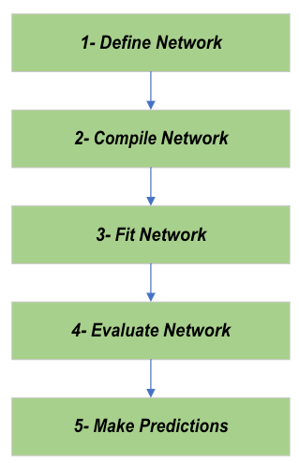
Keras Model Life-Cycle
1- Define Network
2- Compile Network
3- Fit Network
4- Evaluate Network
5- Make Predictions

Slide 6
Keras Coding Example
# Define the network
model = Sequential()
model.add(Dense(5, input_dim=2))
model.add(Activation('relu’))
# Compile the network
algorithm = SGD(lr=0.1, momentum=0.3)
model.compile(optimizer=algorithm, loss='mean_squared_error’)
# Fit the network
history = model.fit(X, y, batch_size=10, epochs=100)
# Evaluate the network
loss, accuracy = model.evaluate(X, y)
#Make Predictions
predictions = model.predict(X)

Slide 7
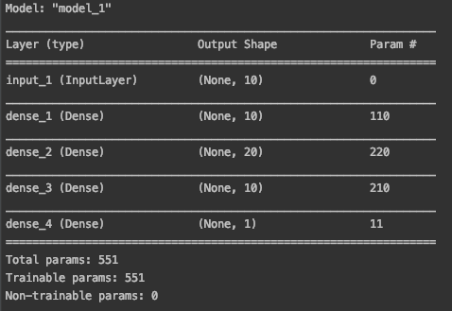
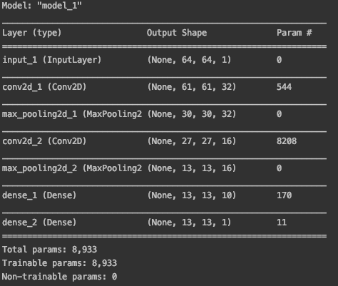
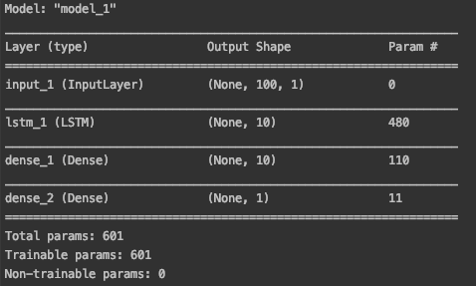
Demonstrate mlp, cnn, rnn

Slide 8
The techniques

Slide 9
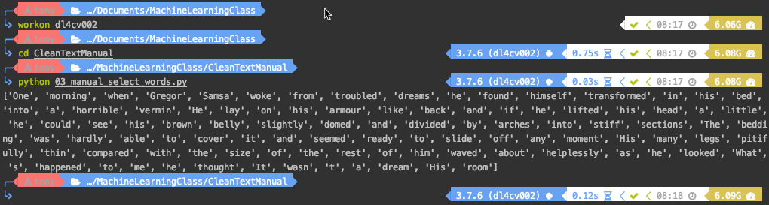
Split the word with white space
# load text filename = 'metamorphosis_clean.txt' file = open(filename, 'rt') text = file.read() file.close() # split into words by white space words = text.split() print(words[:100])

Slide 10
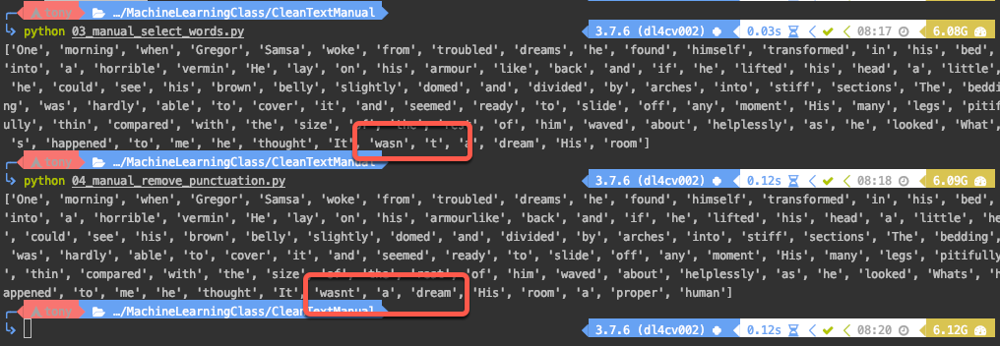
Remove Punctuation Manually
# prepare regex for char filtering re_punc = re.compile('[%s]' % re.escape(string.punctuation)) # remove punctuation from each word stripped = [re_punc.sub('', w) for w in words]

Slide 11
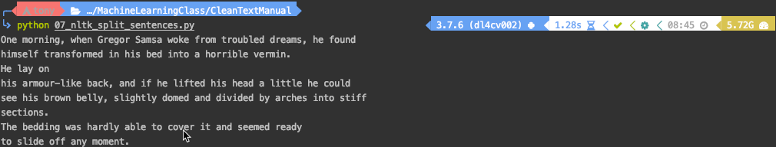
Split sentences
from nltk import sent_tokenize # load data filename = 'metamorphosis_clean.txt' file = open(filename, 'rt') text = file.read() file.close() # split into sentences sentences = sent_tokenize(text) print(sentences[0])

Slide 12
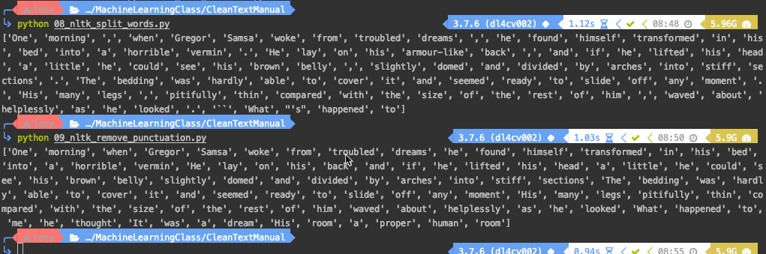
nltk

Slide 13
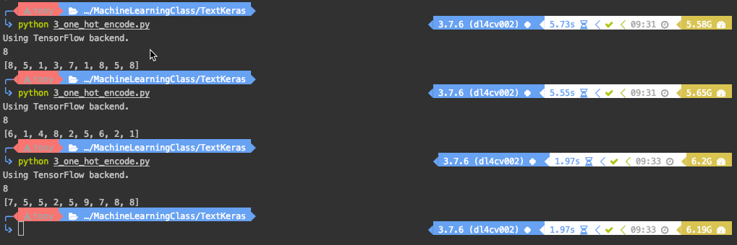
Keras: One Hot Encode
from keras.preprocessing.text import one_hot from keras.preprocessing.text import text_to_word_sequence # define the document text = 'The quick brown fox jumped over the lazy dog.' # estimate the size of the vocabulary words = set(text_to_word_sequence(text)) vocab_size = len(words) print(vocab_size) # integer encode the document result = one_hot(text, round(vocab_size*1.3)) print(result)

Slide 14
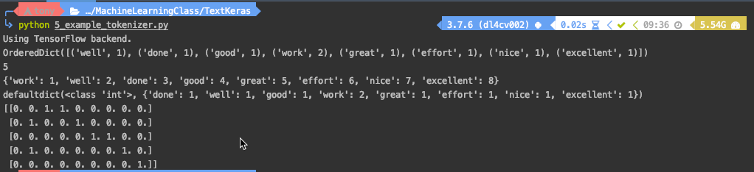
Keras: Tokenizer API
from keras.preprocessing.text import Tokenizer # define 5 documents docs = ['Well done!', 'Good work', 'Great effort', 'nice work', 'Excellent!'] # create the tokenizer t = Tokenizer() # fit the tokenizer on the documents t.fit_on_texts(docs) # summarize what was learned print(t.word_counts) print(t.document_count) print(t.word_index) print(t.word_docs) # integer encode documents encoded_docs = t.texts_to_matrix(docs, mode='count') print(encoded_docs)

Slide 15
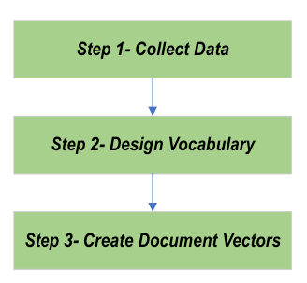
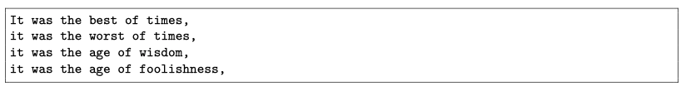
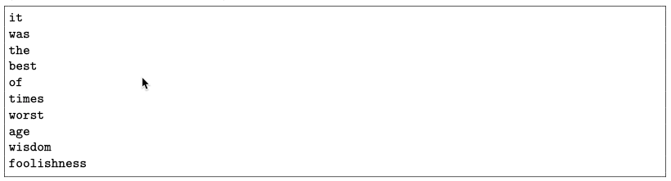
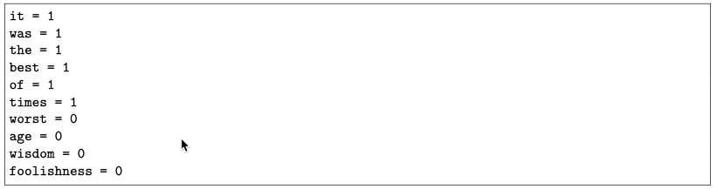
Bag of words modeling

Slide 16
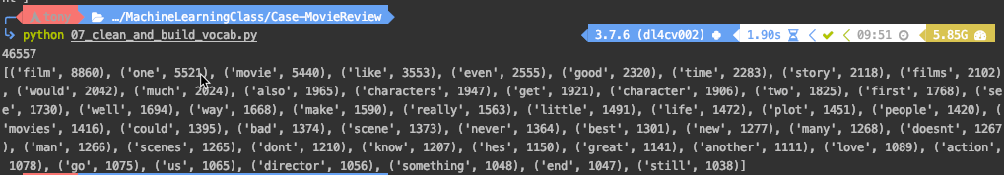
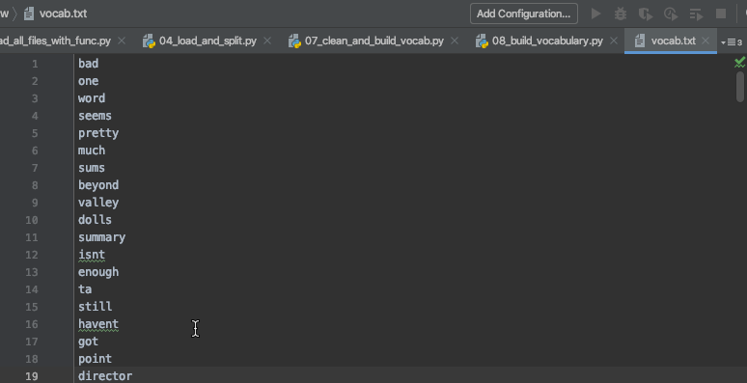
Example : Movie Review
Clean Text and Build Vocab
Save to txt file

Slide 17
Code
from nltk.corpus import stopwords
stop_words = set(stopwords.words('english')) tokens = [w for w in tokens if not w in stop_words]
save_list(tokens, 'vocab.txt')

Slide 18
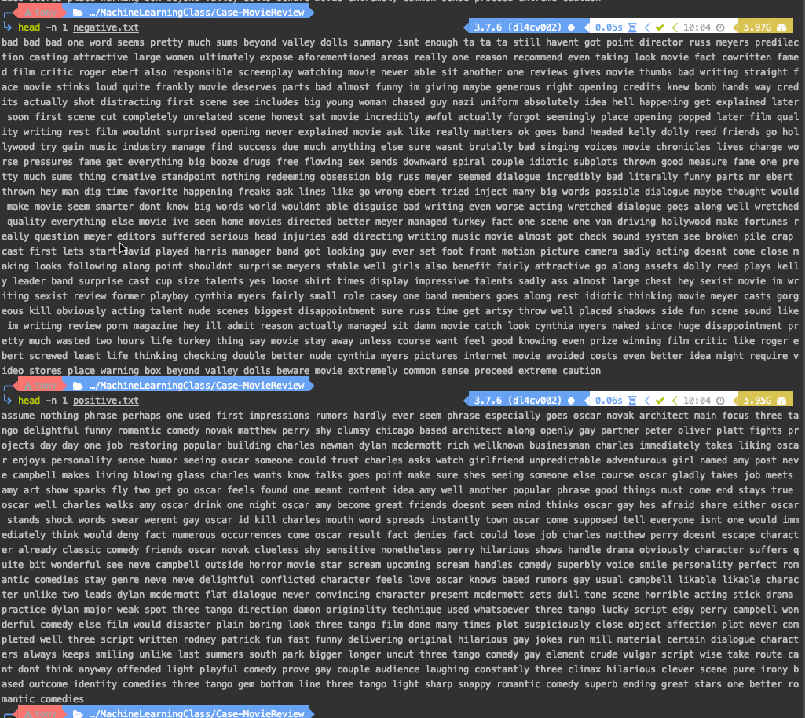
Divide Vocab into Negative and Positive Review
# load vocab vocab_filename = 'vocab.txt' vocab = load_doc(vocab_filename) vocab = vocab.split() vocab = set(vocab) # negative vocab negative_lines = process_docs('txt/neg', vocab) save_list(negative_lines, 'negative.txt') # positive vocab positive_lines = process_docs('txt/pos', vocab) save_list(positive_lines, 'positive.txt')

Slide 19
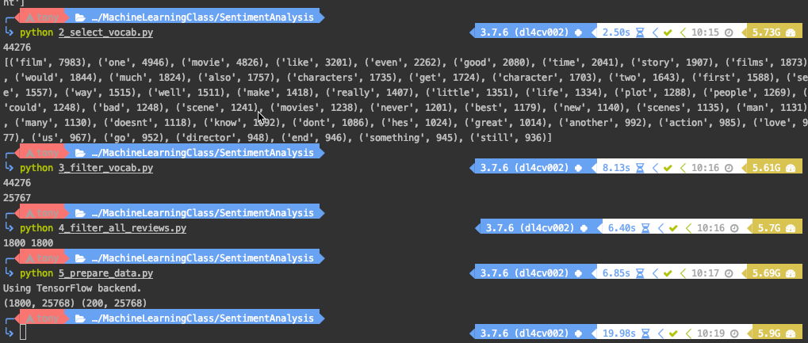
Project: Bag of word model for sentiment analysis
Step 1: Clean review
Step 2: Select Vocab
Step 3: Filter Vocab and save as vocab.txt
Step 4: Assign label to vocab
Step 5: Prepare Data
Step 6: Build Neural mlp model
Step 7: Compare encoding
Step 8: Prediction

Slide 20
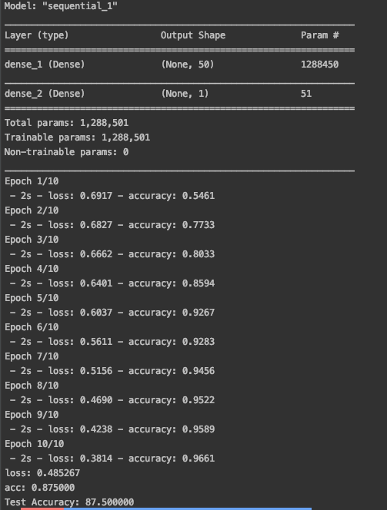
Build mlp and the result

Slide 21
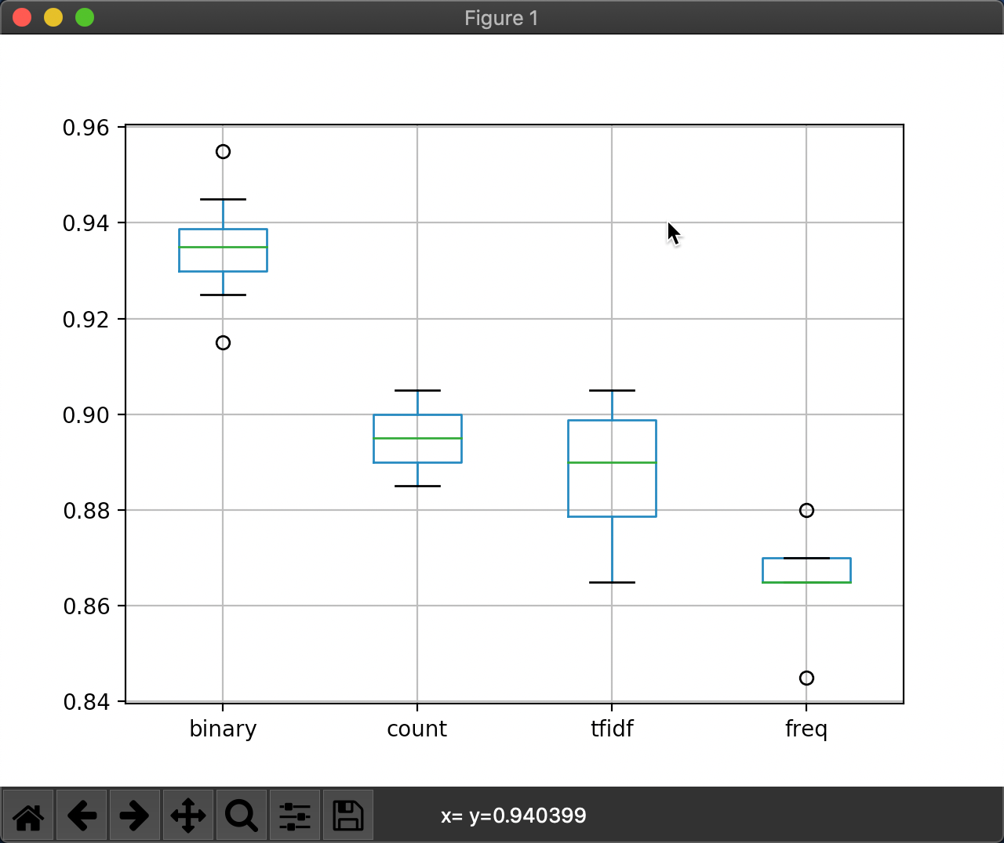
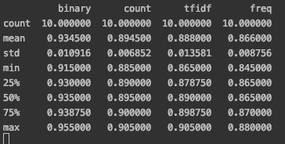
Encoding Compare the accuracy
We can see that binary achieved the best results with a modest spread and might be the preferred approach for this dataset

Slide 22
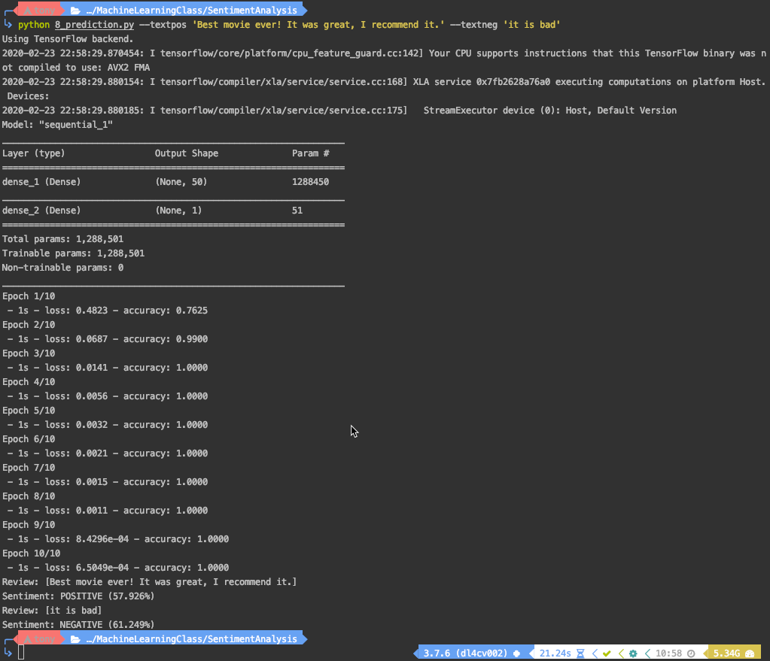
Make Prediction

